Slide 1
Decision Trees
beyond ID3
Aditya Gupta: 2K15/CO/015
Anurag Malyala: 2K15/CO/035

Slide 2
Limitations and Shortcomings of ID3
Building up to C4.5

Slide 3
Issues with ID3
Tendency to overfit. ID3 is overly sensitive to features with large number of values.
Can’t handle continuous values.
Can’t handle missing values.
Can’t handle attributes with differing costs.
Pruning limitations.

Slide 4
C4.5
Quinlan, J. R. C4.5: Programs for Machine Learning. Morgan Kaufmann Publishers, 1993

Slide 5
Improvements over ID3
The algorithm inherently employs Single Pass Pruning Process to Mitigate overfitting.
Handling both continuous and discrete attributes - In order to handle continuous attributes, C4.5 creates a threshold and then splits the list into those whose attribute value is above the threshold and those that are less than or equal to it
Handling training data with missing attribute values - C4.5 allows attribute values to be marked as ? for missing. Missing attribute values are simply not used in gain and entropy calculations.
Pruning trees after creation - C4.5 goes back through the tree once it's been created and attempts to remove branches that do not help by replacing them with leaf nodes.
Improved computational efficiency.

Slide 6
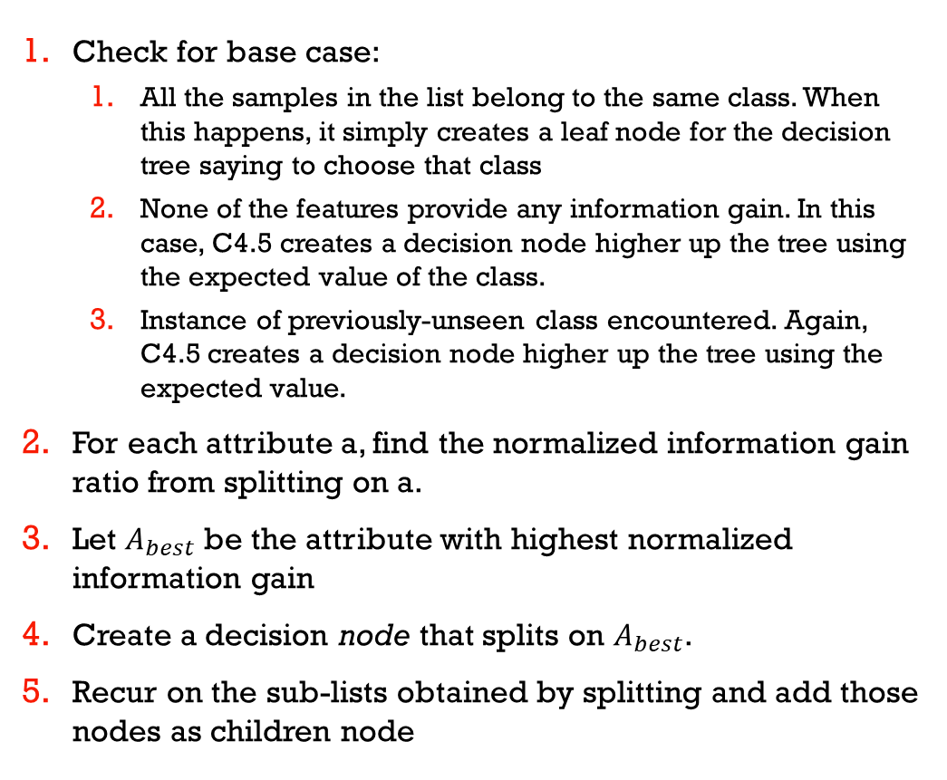
C4.5 Pseudo-code
Check for base case:
All the samples in the list belong to the same class. When this happens, it simply creates a leaf node for the decision tree saying to choose that class
None of the features provide any information gain. In this case, C4.5 creates a decision node higher up the tree using the expected value of the class.
Instance of previously-unseen class encountered. Again, C4.5 creates a decision node higher up the tree using the expected value.
For each attribute a, find the normalized information gain ratio from splitting on a.
Let $A_{best}$ be the attribute with highest normalized information gain
Create a decision node that splits on $A_{best}$.
Recur on the sub-lists obtained by splitting and add those nodes as children node

Slide 7
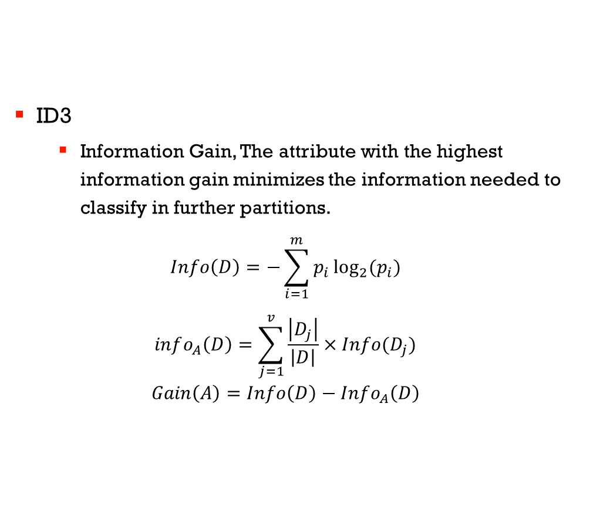
Attribute selection measures
ID3
Information Gain, The attribute with the highest information gain minimizes the information needed to classify in further partitions.
$$Info\left(D\right)=−\sum_{i=1}^{m}{p_{i}\log_{2}{(p_{i})}}$$
$$info_{A}\left(D\right)=\sum_{j=1}^{v}{\frac{\left|D_{j}\right|}{\left|D\right|}×Info(D_{j})}$$
$$Gain\left(A\right)=Info\left(D\right)−Info_{A}\left(D\right)$$

Slide 8
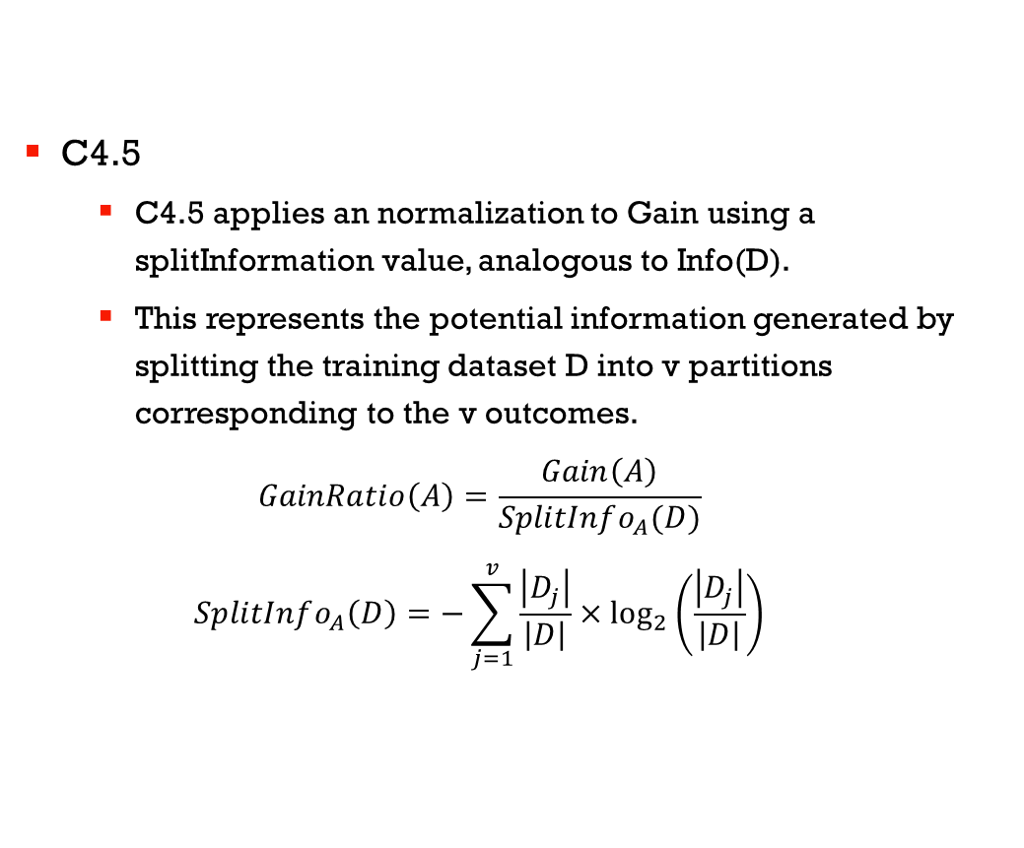
Attribute selection measures
C4.5
C4.5 applies an normalization to Gain using a splitInformation value, analogous to Info(D).
This represents the potential information generated by splitting the training dataset D into v partitions corresponding to the v outcomes.
$$GainRatio\left(A\right)=\frac{Gain\left(A\right)}{SplitInfo_{A}(D)}$$
$$SplitInfo_{A}\left(D\right)=−\sum_{j=1}^{v}{\frac{\left|D_{j}\right|}{\left|D\right|}×\log_{2}\left(\frac{\left|D_{j}\right|}{\left|D\right|}\right)}$$

Slide 9
Handling Continuous values
C4.5 also manages the cases of attributes with values in continuous intervals as follows.
Let us say that Ci attribute a continuous interval of values.
Examines the values of this attribute in the training data. Let that these values are in ascending order, A1, A2, ..., Am
Then for each of these values, the partitioned between records those that have values of C, less than or equal to Aj and those which have a value larger then Aj values.
For each of these partitions gain is calculated, or the gain ratio and the partition that maximizes the gain is selected.

Slide 10
Another Decision Tree Learner
CART: Classification and Regression Trees

Slide 11
CART: Classification and Regression Trees
This method is similar to both ID3 and C4.5 the two key differences here being
It uses the Gini Index for attribute selection
It can also be used for Regression without a lot of modification

Slide 12
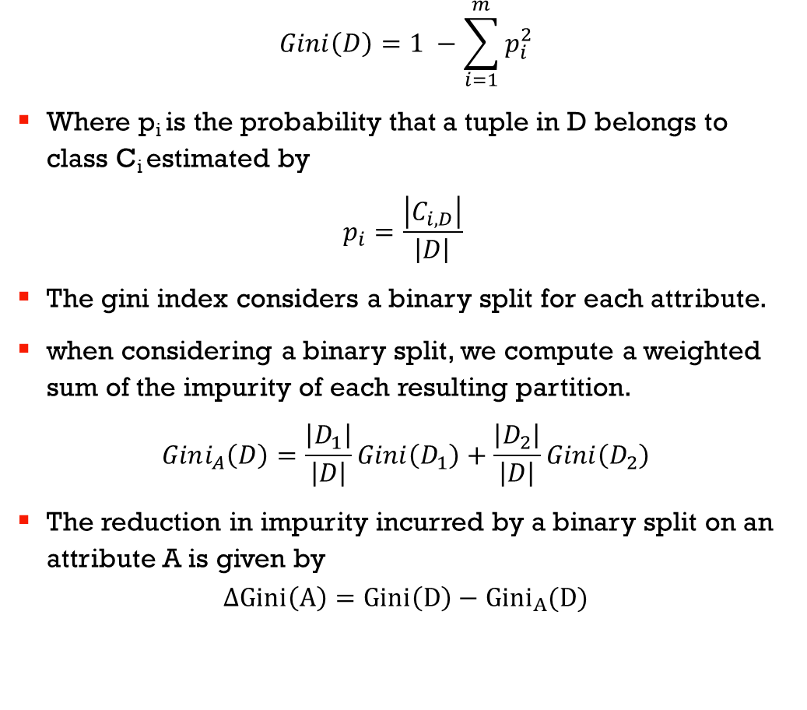
Gini Index
$$Gini\left(D\right)=1 −\sum_{i=1}^{m}{p_{i}^{2}}$$
Where p_{i} is the probability that a tuple in D belongs to class C_{i} estimated by
$$p_{i}=\frac{\left|C_{i, D}\right|}{\left|D\right|}$$
The gini index considers a binary split for each attribute.
when considering a binary split, we compute a weighted sum of the impurity of each resulting partition.
$$Gini_{A}\left(D\right)=\frac{\left|D_{1}\right|}{\left|D\right|}Gini\left(D_{1}\right)+\frac{\left|D_{2}\right|}{\left|D\right|}Gini\left(D_{2}\right)$$
The reduction in impurity incurred by a binary split on an attribute A is given by
$$ΔGini\left(A\right)=Gini\left(D\right)−{Gini}_{A}(D)$$

Slide 13
C4.5 example
Day | Outlook | Temp | Humidity | Wind | Decision
1 | S | 85 | 85 | W | N
2 | S | 80 | 90 | F | N
3 | O | 83 | 75 | W | Y
4 | R | 70 | 96 | W | Y
5 | R | 68 | 80 | W | Y
6 | R | 65 | 70 | F | N
7 | O | 64 | 65 | F | Y
8 | S | 72 | 95 | W | N
9 | S | 69 | 70 | W | Y
10 | R | 75 | 80 | W | Y
11 | S | 75 | 70 | F | Y
12 | O | 72 | 90 | F | Y
13 | O | 81 | 75 | W | Y
14 | R | 71 | 80 | F | N

Slide 14
A = wind
Entropy(D) = -(9/14)log(9/14) – (5/14)log(5/14) = 0.94
Gain(D, wind) = Entropy(D) – Sum(p(D|wind) * Entropy(D|wind))
Entropy(D|wind=W) = -(2/8)log(2/8) – (6/8)log(6/8) = 0.811
Entropy(D|wind=F) = -(3/6)log(3/6) – (3/6)log(3/6) = 1
Gain(D, wind) = 0.94 – (8/14)(0.811) – (6/14)(1) = 0.049
splitInfo(D, wind) = -(8/14)log(8/14) – (6/14)log(6/14) = 0.985
GainRatio(D, wind) = 0.049 / 0.985 = 0.049

Slide 15
A = outlook
Gain(D, outlook) = Entropy(D) – Sum(p(D|outlook) * Entropy(D|outlook))
Entropy(D|outlook=S) = -(3/5)log(3/5) – (2/5)log(2/5) = 0.97
Entropy(D|outlook=O) = -(0/4)log(0/4) – (4/4)log(4/4) = 0
Entropy(D|outlook=R) = -(2/5)log(2/5) – (3/5)log(3/5) = 0.97
Gain(D, outlook) = 0.94 – 3*(5/14)(0.97) – (4/14)(0) = 0.246
splitInfo(D, wind) = -2*(5/14)log(5/14) – (4/14)log(4/14) = 1.577
GainRatio(D, wind) = 0.246 / 1.577= .155

Slide 16
A = Humidity (interval splits)
Gain(D, Humidity <>78) = 0.09, GainRatio(D, humidity <>78) = 0.09
Gain(D, Humidity <>80) = 0.101, GainRatio(D, humidity <>80) = 0.101
Gain(D, Humidity <>85) = 0.024, GainRatio(D, humidity <>85) = 0.024
Gain(D, Humidity <>90) = 0.01, GainRatio(D, humidity <>90) = 0.01
Gain(D, Humidity <>95) = 0.048, GainRatio(D, humidity <>95) = 0.048

Slide 17
outlook
S
R
O
wind
humidity
YES
>80
<=80
F
W
NO
YES
NO
YES

Slide 18
Decision Trees Pruning
Handling Overfitting

Slide 19
Pruning
Many branches in the tree can reflect noise or anomalies in the data.
Pruning addresses these problems by removing the least reliable paths in the tree
Pruned trees are
Smaller
Less complex
Easier to comprehend
Faster

Slide 20
Pruning strategies
There are two approaches to pruning
Pre-pruning
Post-pruning

Slide 21
Pre-pruning
Also called early halting, the subtree construction halts when some measure falls below a threshold
The halted node becomes the leaf, the class may be set to the most common class in the tuples
Measures like statistical significance, information gain, gini index can be used as metrics for early halting.
The difficulty with pre-pruning is setting the threshold, a high threshold would cause oversimplified trees and low thresholds wont solve overfitting.

Slide 22
Post-Pruning
This the more common approach to pruning
Let the tree grow to its entirety
Then trim back the nodes in a bottom up fashion, if by trimming a node there’s a improvement, keep it.

Slide 23
Cost Complexity Pruning
CART uses Cost Complexity pruning.
This approach considers the cost complexity of the tree as a function of the number of leaves in the tree and the error rate of the tree.
It starts from the bottom, for each internal node, N, it computes the cost complexity of the sub-tree at N and the cost if the sub-tree was removed, if the resulting cost is smaller, the tree is pruned.
A pruning set of class labels is used to calculate the cost complexity, this is independent of the training set.
Progressively pruned trees are generated, in general the smallest tree is the best one.

Slide 24
Pessimistic Pruning
C4.5 uses Pessimistic pruning
Similar to Cost Complexity Pruning, but does not require a pruning set.
Instead, it uses the training set to estimate error rates.
To avoid bias the error rate is adjusted with a penalty so as to counter the bias.

Slide 25
Pruning
Post pruning requires significantly more computation than pre-pruning but generally leads to better and more reliable trees.
Apart from this replication and repetition are two factors which can degrade performance of trees.
Repetition occurs when the same attribute is repeatedly tested for the same value.
Replication occurs when a subtree exists which is exactly same as a tree higher up in the hierarchy.
This can be alleviated through the use of multivariate splits and using alternative forms of knowledge representation like rule based trees.

Slide 26
Conclusion
C4.5 improves over ID3 by adding a normalization term and handles missing and continuous values.
C4.5 uses an pessimistic pruning strategy.
CART can do both classification and regression and is a more general decision tree learner.
CART uses an pruning set for doing Cost Complexity Pruning.
Decision Trees are good for small to medium sized datasets, their efficiency goes down for large datasets. BOAT and AVC are approaches to handle this but they also work up to a certain extent.

Slide 27
Questions?

